Slide 1


HOPE Foundation’s
Finolex Academy Of Management And Technology, Ratnagiri
Department of Computer Science and Engineering (AI & ML)
BOOKLET AI
Under the guidance of Presented by
Prof. Name Mrs. Sprooha Athalye Ved Khanvilkar (R-24-0496)
Shwet Kadam (RD-25-0001)
Arya Karambelkar (R-24-0176)
Sahil Kazi (RD-25-0006)

Slide 2
CONTENTS:
INTRODUCTION
PROBLEM STATEMENT
SYSTEM ARCHITECTURE/OVERVIEW
EXISTING SYSTEMS & LIMITATIONS
EXISTING SYSTEM & THEIR LIMITATIONS
HOW ? BOOKLET AI OVERCOME THIS LIMITATIONS
DEMONSTRATION
SCOPE OF THE PROJECT
FUTURE SCOPE

Slide 3
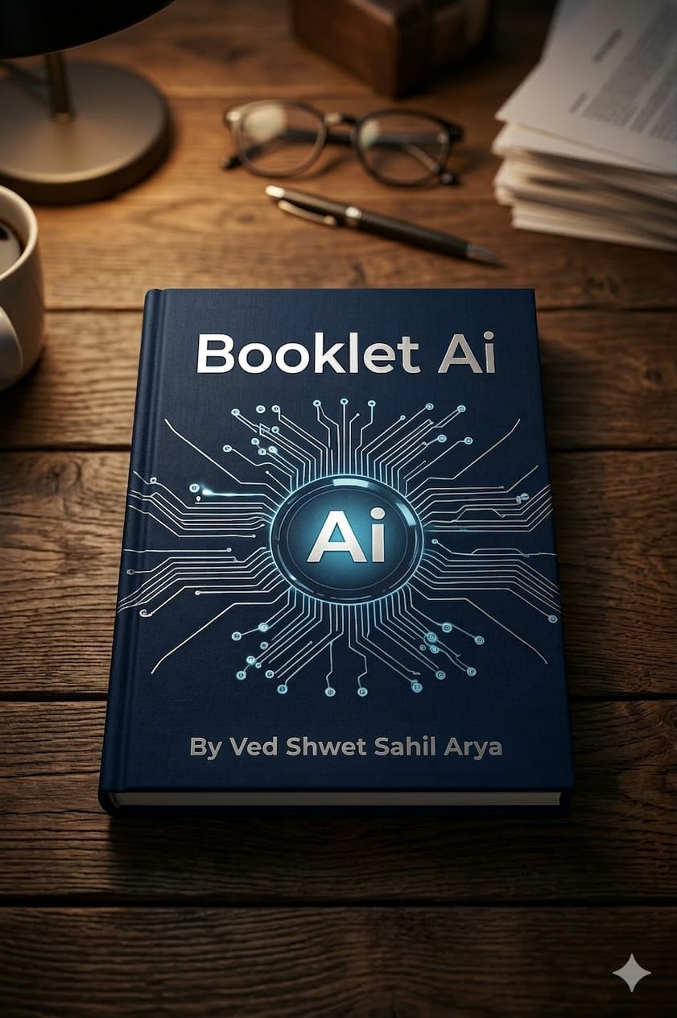
INTODUCTION
Booklet AI
Transform raw study materials into structured booklets using AI-powered automation
Background of the Project
With the rapid growth of digital systems, managing tasks and information efficiently has become important. AI-based solutions help automate processes, improve accuracy, and save time in many applications.
Why the Project is Important
This project demonstrates how AI can be used to simplify real-world problems and improve efficiency. It helps users complete tasks faster while reducing manual effort
Notes:
null

Slide 4

Problem Statement
What Problem Are You Solving?
Booklet AI automatically converts raw educational content into clean, structured study booklets and provides AI-generated notes through a chatbot
Why This Problem Matters
Organized study material improves understanding, saves time, and helps students prepare more effectively for exams.
Current Issues or Limitations
Study materials are often messy and poorly structured.
Manual organization of notes is time-consuming.
Existing tools do not automatically convert files into structured study booklets.
Students
Educators
Professionals
Spending hours organizing lecture slides, PDFs, and notes
Need efficient content repurposing tools
Require quick study aid generation
Notes:
null

Slide 5
System Architecture/Overview
Input
1
File upload or text paste
2
Extract
Raw text from PDF/PPT/TXT
Clean
3
Fix artifacts and normalize
4
Structure
Markdown formatting
Generate
5
PDF booklet creation
6
Chat
AI-powered notes
Notes:
null

Slide 6


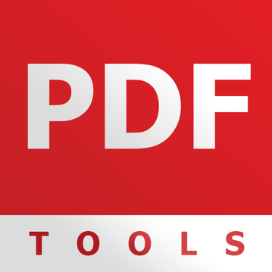
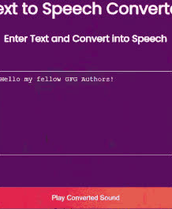
Existing Systems & Limitations
Notion / Google Docs
No automation for content structuring
Manual PDF Tools
Time-intensive editing required
Basic Converters
Cannot extract or enhance meaning
Notes:
null

Slide 7
Existing Systems and Their Disadvantages
1. Notion / Google Docs
Mainly used for manual note-taking and document editing.
Requires users to manually organize and format study materials.
No automatic conversion of PDFs or PPTs into structured study booklets.
2. Manual PDF Tools
Used only for viewing, editing, or merging PDF files.
Do not provide intelligent content extraction or restructuring.
Time-consuming to manually organize study content.
3. Basic File Converters
Only convert files from one format to another (e.g., PDF to text).
Do not clean, structure, or summarize the content.
Output often remains unorganized and difficult to study.

Slide 8


How Booklet AI Overcomes These Limitations
Automatically transforms unstructured PDFs, PPTs, and text into clean, structured study booklets with intelligent note generation
Rule-based text extraction
Smart content structuring
Professional PDF generation
AI-powered chatbot for notes
Expected Outcome
The system will successfully convert raw educational content (PDF, PPT, or text) into a clean, structured study booklet in PDF format. It will also provide AI-generated notes through a chatbot, helping students quickly understand and revise the study material.
Notes:
null

Slide 9

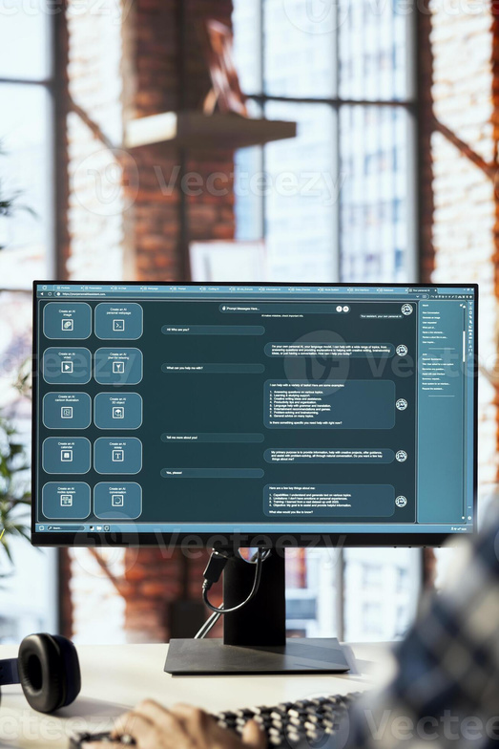
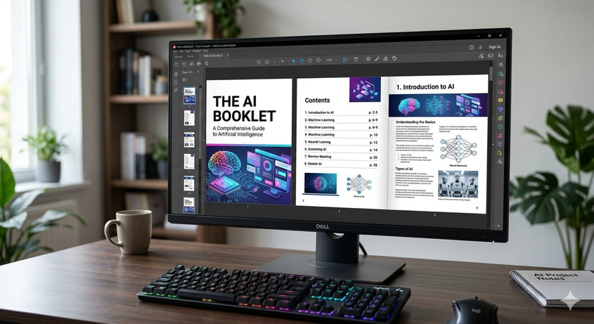
Demonstration
Step 1: Upload Study Material
User uploads a PDF, PPT, or TXT file containing raw study content into the Booklet AI system.
Step 2: AI Processing
The system extracts, cleans, and structures the text using rule-based processing and AI logic.
Step 3: Generate Study Booklet
A well-structured downloadable PDF booklet is automatically generated for easy reading and exam preparation.

Slide 10
Scope of Project
Booklet AI can be used to automatically convert unorganized educational content into structured study booklets and generate AI-based notes to make learning easier and faster.
Where the Project Can Be Used
Schools and colleges for study material preparation
Students for exam revision and self-study
Teachers for organizing lecture notes and presentations
Limitations
AI notes generation requires an internet connection and API access.
Accuracy depends on the quality of the input files (PDF/PPT/text).
Target Users
Students, teachers, and anyone who wants to convert raw study materials into organized notes and booklets.

Slide 11
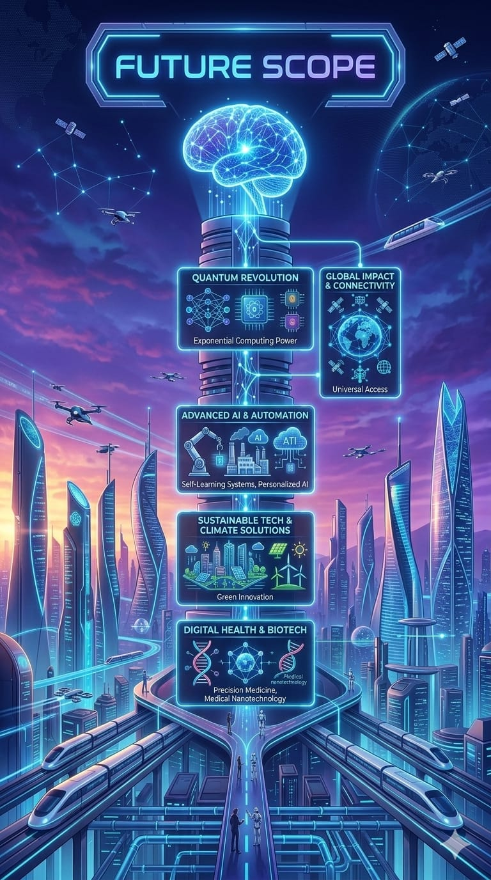



Future Scope
RAG implemented ChatBot
Improved rule based NLP
Notes:
null

Slide 12


Slide 13
ANY QUERIES ?

